Slide 1

HEART DISEASE RISK AMONG MEN AND WOMEN FOR DIFFERENT AGE GROUPS
Name : Danita Anubhuti Prakash
Student ID : s4745511
Notes:
Data Set Selected from Kaggle : https://www.kaggle.com/datasets/johnsmith88/heart-disease-dataset
Data Cleaning:
Changed Sex columns values : 0 to Female and 1 to Male
Changed the value of Exagenda (Exercise Agenda) from 0 to no and 1 to yes

Slide 2

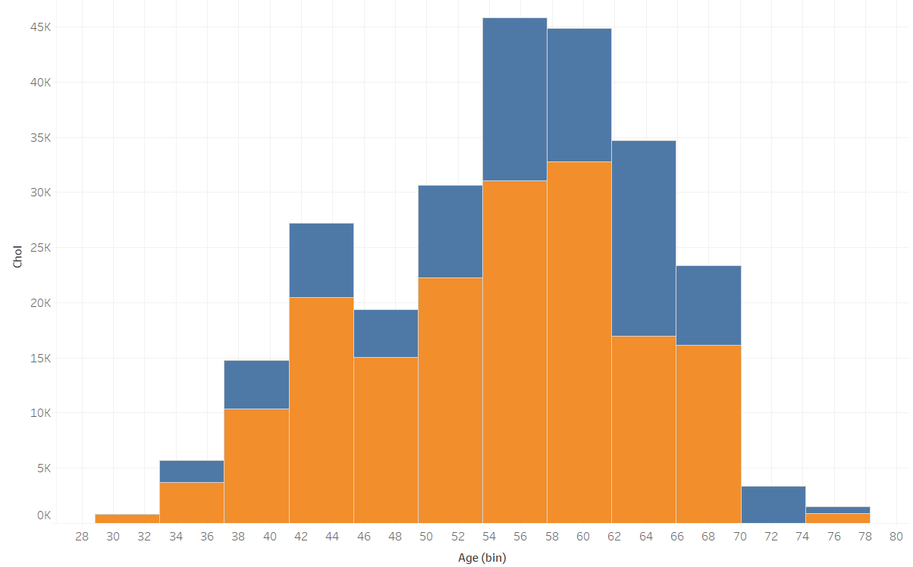

CHOLESTROL LEVEL : Men VS WOMEN
It is clear that women have higher HDL cholesterol than men especially in the age group 54 to 58.
Notes:
Age on the X- axis
Serum Cholesterol in mg/dl in y axis
Here HDL is chosen i .e. High Density Lipid Cholestrol.

Slide 3
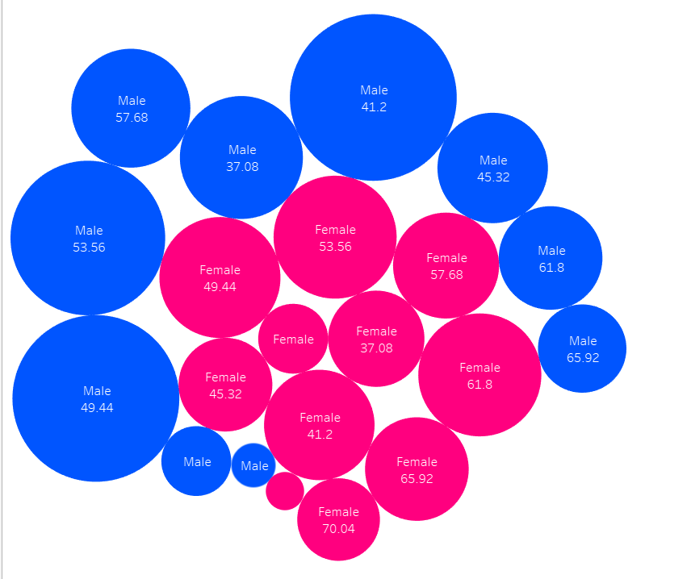

HEART RISK: MEN VS WOMEN
Men are seen to have a higher chance of heart attack than women.
Notes:
This is due to the fact that these men have lower HDL cholesterol which puts them at a higher risk of heart disease.
HDL (high-density lipoprotein), or “good” cholesterol, absorbs cholesterol and carries it back to the liver. The liver then flushes it from the body.

Slide 4


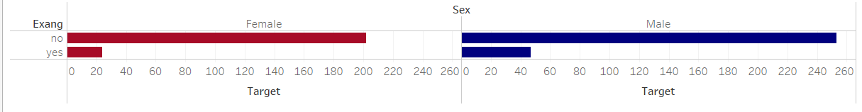
Exercise Makes a Difference!
Conclusion: It is clear from the above graphs that the people who exercised reduced the risk of a heart disease significantly.
Notes:
Y AXIS
Exang : Exercise Agenda
Yes : The person(male or female ) started practising an exercise agenda
No : Did not start practising an exercise agenda
X AXIS
Target : Risk of Heart Disease

